Slide 1


THE ZOOSYSTEM: AN OPEN-SOURCE MOVEMENT ANALYSIS TOOLBOX FOR MATLAB
Philippe Dixon¹, JJ Loh², Yannick Michaud-
Paquette³, and David J. Pearsall³
¹Department of Engineering Science, University of Oxford, Oxford, UK
²Medicus Corda. Montreal, Canada
³Department of Kinesiology, McGill University, Montreal, Canada
May 2015

Slide 2


Describe some general data processing problems
Introduction to the key features of the zoosystem
Use zoosystem to process sample data set (practice session!)
Intended users:
Novice programmers or persons new to biomechanics
Expert users wishing to add/improve content

Slide 3



Slide 4



“ I need to calculate the min knee angle, it’s easy. I open each trial in Vicon, find the point on the curve, and enter it into an excel sheet sorted by condition – I’ve only had to repeat this 500 times, oh wait I actually wanted the max…”
“I had a massive script to process my thesis – it was amazing. I’m working on a new project now and am building a new crazy script, it’s totally different”
Logical / clear
Largely automated
Generalizable to new data or research projects

Slide 5

  Multiple conditions/groups assessed
  Numerous trials are collected
  Trials contains multiple channels
  Each channel contains a large number of data points recorded over a time interval
Notes:
itions/groups are assessed
Numerous trials are collected
Each trial contains multiple channels (sometimes from different devices)
Each channel contains a large number of data points

Slide 6


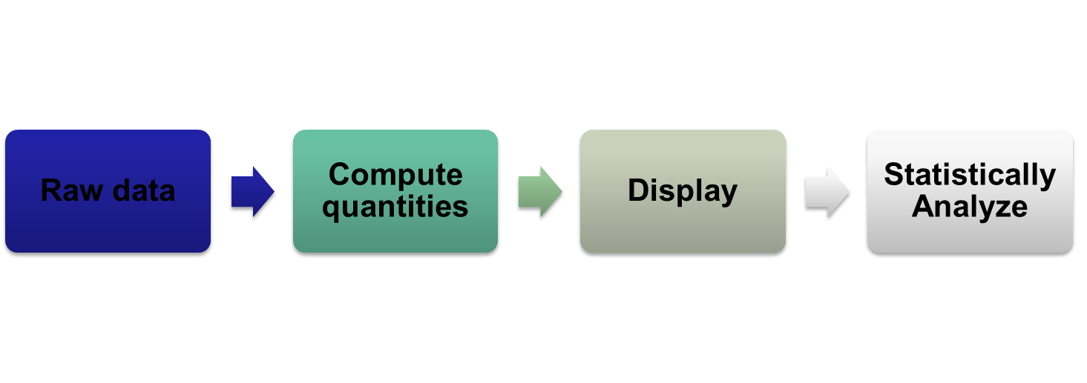

Slide 7



Slide 8

First developed by Loh (2004)
Used to process data from numerous papers (15 and counting)
Based on two simple tenants:
-Avoid repetitive (manual) tasks
-Strive for parsimony
Implemented in Matlab
Updated to current to zoo standard v1.2.0 in January 2014
Anticipated release of smaller updates and upgraded features June 2015 (v1.2.1)

Slide 9

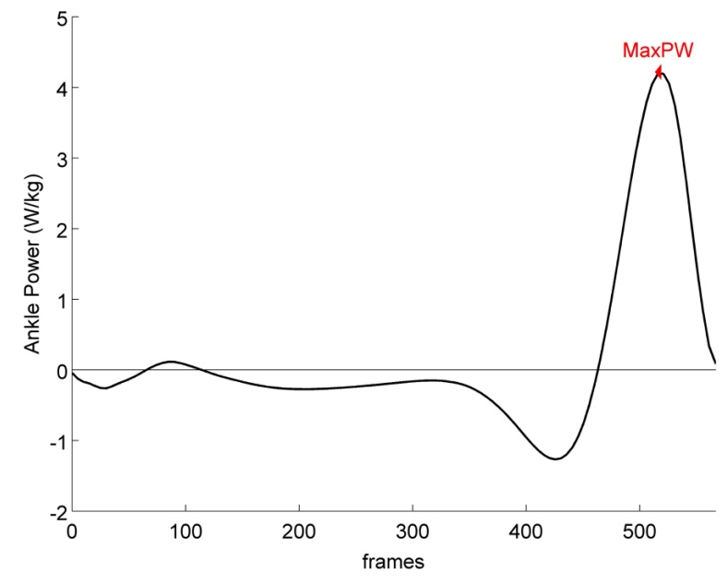

Each branch is made up of “line” and “event” subfields
- Line: contains actual data
vector
- Event contains info about a
point
An additional channel “Zoosystem” contains meta information about the trial (e.g. Anthropometrics, diagnosis, date collected)

Slide 10

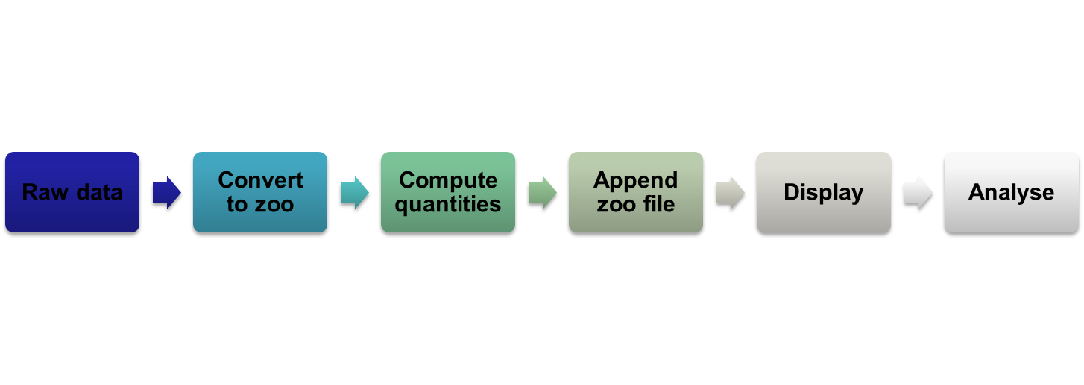
The zoosystem allows you to navigate these steps with (relative) ease

Slide 11



Slide 12

We will explore the main features of the zoosystem through a hypothetical study (see ‘esmac_2014_poster.pdf’ for a summary of the process)
Navigate to the root zoosystem folder on your computer and open ‘Help Files/zoo_process_example.m’
The’ zoo_process_example’ m-file explains the steps.*
The data associated with this study are found in ‘Sample Study’
* User’s should be familiar with Matlab basics before attempting the practice session.

Slide 13


Download at: https://Github.com/PhilD001/the-zoosystem
main contact: philippe.dixon@gmail.com
If used in the preparation of your manuscript, please reference:
Dixon PC, Loh JJ, Michaud-Paquette Y, Pearsall DJ. The Zoosystem: An Open-Source Movement Analysis Matlab Toolbox. Proceedings of the 23rd meeting of the European Society of Movement Analysis in Adults and Children. Rome, Italy .Sept 29-Oct 4th 2014.

